Slide 1


Revenue maximization, monopoly pricing, price discrimination, bundling, two-part tariffs & adverse selection
John Horn

Slide 2
Practical application
Economic concept
Practical business application
Revenue maximization
Optimizing revenue
Marginal revenue
Incremental revenue
What’s the impact on revenue growth? (MR > 0)
What’s the hit to revenue? (MR < 0)
Price discrimination
Customer segmentation
Product portfolio
Adverse selection
Who are the least profitable customers, and how many of them are there?

Slide 3
Agenda
Revenue maximization
Monopoly pricing
Price discrimination
Two-part tariffs
Bundling
Adverse selection
American Airlines case

Slide 4
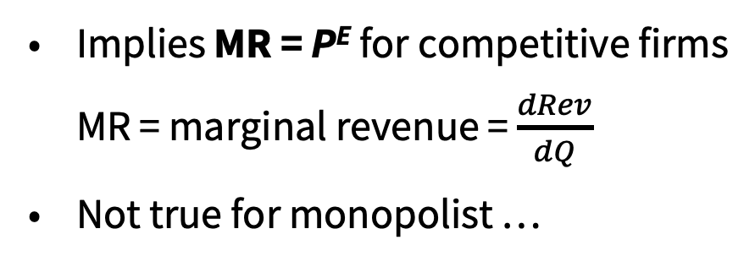

Revenue and marginal revenue
Revenue for an individual competitive firm (i) is:
Revenue_{i} = P^{E} x Q_{i}
Changes to Q_{i} do not affect P^{E}, so the extra revenue from selling another unit of output is always just P^{E}
Revenue
$
R_{i}
P^{E}
Implies MR = P^{E} for competitive firms
MR = marginal revenue = $\frac{dRev}{dQ}$
Not true for monopolist …
Q_{i}

Slide 5

Revenue and demand
Suppose as a monopolist you have collected information on demand
P = 200 – 0.25Q
or Q = 800 – 4P
How much revenue is returned by a price of P₁?
R₁ = P₁ x Q(P₁)
Example: P₁ = 50, so Q₁ = 600 and R₁ = 30,000

Slide 6
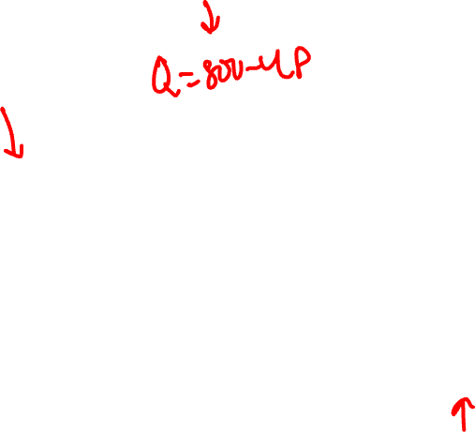
Revenue and demand
Demand
P = 200– 0.25Q
Revenue
P x Q
Example:
P₁ = 50
Q₁ = 600
R₁ = 30,000
P
200
50
Revenue
D
Q
600
800

Slide 7
Change in revenue
What happens to revenue as you decrease price by a small amount, –dP?
All Q₁ customers buying at P₁ are now contributing less to revenue
Change is –Q₁ x dP
Some additional customers will purchase because the price is lower
Look at the demand curve to see magnitude of this effect (dQ)
Additional revenue is dQ x (P₁ – dP) = dQ x P₁ – dQ x dP
The term dQ x dP is very small, so we ignore it
Total change in revenue is
dR = dQ x P₁ – Q₁ x dP

Slide 8
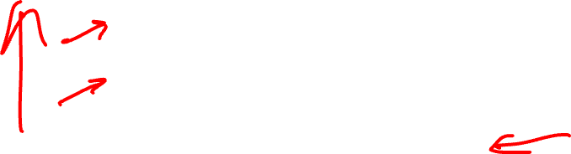
Marginal revenue
Marginal revenue (MR)
Decrease price: Balancing additional revenue from new customers and less revenue from existing ones
Increase price: Balancing less revenue from lost customers and additional revenue from remaining ones
MR in terms of Q change
Flip the argument to quantity (instead of price) changes
One-to-one relationship between P and Q along demand
Revenue change when Q changes by a small amount
↑Q: Additional revenue from new customers, less revenue from existing ones
↓Q: Less revenue from lost customers, additional revenue from remaining ones
Crucial when we consider profit maximization
Costs are in terms of quantity, not price

Slide 9
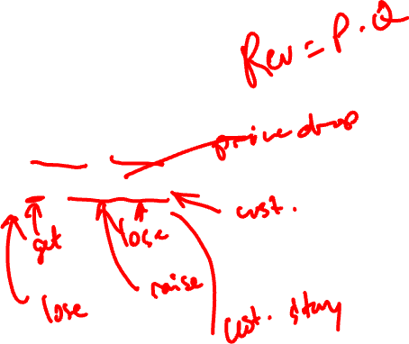
Understanding marginal revenue
Remember: for Q to go up, P must fall
Revenue
= P x Q
dR
= P x dQ + dP x Q
dR/dQ
= P + (dP/dQ) x Q
Marginal revenue
How much does revenue change when Q changes by a small amount?
Slope of demand
By how much does P need to fall to generate an additional dQ?

Slide 10
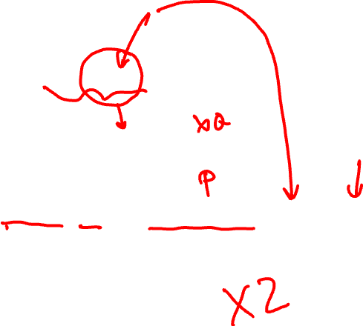
Marginal revenue: Example
Return to our sample demand curve
P = 200 – 0.25Q
Revenue is
P x Q = (200 – 0.25Q) x Q
Marginal revenue is
P + (dP/dQ) x Q = (200 – 0.25Q) – (0.25) x Q
= 200 – 0.5Q
Multiply the coefficient in front of Q by 2 (for linear demand curves)

Slide 11
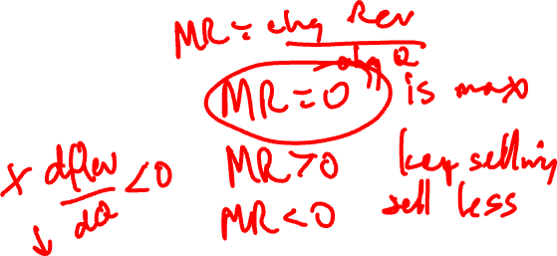
MR and revenue maximization
Revenue is maximized when MR = 0
P
$
MR = 0
R₁
R₁
R
D
Q
Q
Q₁
Q₁
Increase Q until additional benefit from one more sale equals the losses (reduced price) to higher-demand customers

Slide 12
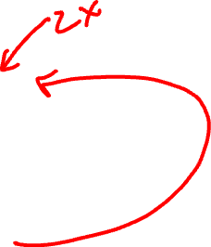
MR and revenue: Example
Demand is
P = 200 – 0.25Q
and MR = 200 – 0.5Q
Revenue is maximized when MR = 0, or
200 – 0.5Q = 0
Q* = 400
Corresponding price and revenue?
P* = 200 – 0.25 x 400 = $100
R* = $100 x 400 = $40,000

Slide 13
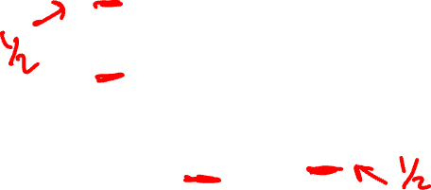
MR and revenue: Example
Demand: P = 200 – 0.25Q
MR = 200 – 0.5Q
P
$
200
40k
100
R
D
Q
Q
400
800
400
MR
Note that we can graph MR along with D
MR is always below

Slide 14
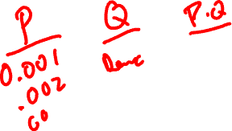
MR and revenue: Example
What if you think Q* = 400 isn’t the right answer?
$
40k
Q₁ = 404, P₁ = 99, so R₁ = $39,996
Q₂ = 396, P₂ = 101, so R₂ = $39,996
R
Revenue is reduced as we move in either direction from the top of the revenue curve
400
Q

Slide 15
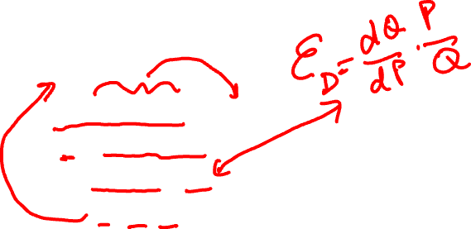
Elasticity and revenue
Key to MR is how strongly consumers react to price changes
This is demand elasticity
Recall: ε_{D} = $\frac{\text{Δ}\text{Q}\text{/}\text{Q}}{\text{Δ}\text{P}\text{/}\text{P}}$ or $\frac{\text{dQ}}{\text{dP}}$ x $\frac{\text{P}}{\text{Q}}$
Revenue maximized where MR = 0
P + (dP/dQ) x Q = 0
P = - (dP/dQ) x Q
1 = - (dP/dQ) x Q/P
1 = - 1/ε_{D}
Revenue maximized when ε_{D} = -1

Slide 16
Elasticity and revenue
How do we interpret the condition ε_{D} = -1?
P
A firm increases price by dP
If demand is inelastic (-1 < ε_{D} < 0) then Q will fall by a smaller % than P increased
$ gain
Revenue gain is greater than revenue loss, so raise prices to raise revenue when -1 < ε_{D}
P₁+dP
$ lost
P₁
When ε_{D} < -1 (elastic), revenue gain is less than revenue loss, so lower prices to raise revenue
D
Q₁-dQ
Q₁
Q

Slide 17
Elasticity and revenue: Example
Return to the demand curve P = 200 – 0.25Q
Already determined revenue is maximized when Q = 400 and P = 100
Could also find this by analyzing elasticity
Elasticity is (dQ/dP) x (P/Q), so 1/ε_{D} = (dP/dQ) x (Q/P)
dP/dQ = –0.25 (the slope of demand)
Replace P with P(Q) and insert dP/dQ = -0.25
1/ε_{D} = –0.25 x Q/(200–0.25Q)
Set equal to –1, do a little algebra, and find Q* = 400

Slide 18
The algebra ...
1/ε_{D} = -0.25 x Q/(200–0.25Q)
-1 = -(1/4) x Q/(200–0.25Q)
4 = Q/(200–0.25Q)
4 x (200–0.25Q) = Q
4 x 200 – 4 x 0.25Q = Q
800 – Q = Q
800 = 2Q
400 = Q

Slide 19
Example: The eclipse
What are the examples of how Carbondale’s business owners were seeking to maximize revenue?
Why were they able to “get away” with these higher prices?
In terms of elasticity?
How will this help them to plan for 2024?
Source: “Carbondale hopes 60,000 eclipse tourists can invigorate city: 'Mother Nature has given us a gift’,” Chicago Tribune, August 18, 2017

Slide 20
Agenda
Revenue maximization
Monopoly pricing
Price discrimination
Two-part tariffs
Bundling
Adverse selection
American Airlines case

Slide 21
Focus on monopolies
Market power
Sophisticated pricing strategies practiced by firms with market power
Easiest to start
Firm doesn’t need to be a true monopoly to use price strategies
Describing in non-monopoly situations is very complicated
Focus on monopoly to concentrate on the basics
Apply to all
Very rarely find true monopolies
Lessons are very helpful for imperfectly competitive markets in general

Slide 22
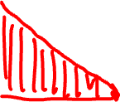
Monopoly pricing
Monopolist maximizes revenue where MR = 0
Where is the consumer surplus on this graph?
If possible, the firm would like to capture this
P
P*
D
Q
Q*
MR

Slide 23
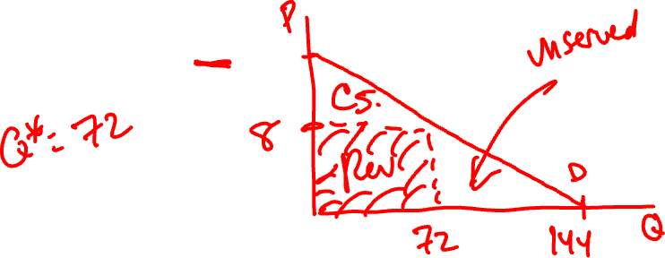
Monopoly revenue maximization example
Find the revenue maximizing quantity (Q) and price (P) for a monopolist who faces the following demand curve:
Q^{D} = 144 – 9P

Slide 24
Review of monopoly pricing
Monopolist sets the high price P* because it must charge all consumers the same price
However, the market demand curve is constructed from the prospective choices of many different types of consumers
Firm could improve revenue if it could charge different people different prices
How would this work?
High demand people: P^{H} > P*
Low demand people: P^{L} < P*

Slide 25
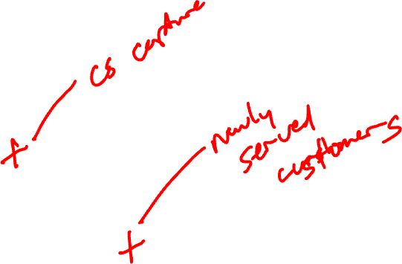
Charging different prices
P
How does this improve revenue relative to only charging P*?
Consumer surplus
Unserved consumers
P^{H}
P*
P^{L}
D
Q
Q*
MR

Slide 26
Agenda
Revenue maximization
Monopoly pricing
Price discrimination
Two-part tariffs
Bundling
Adverse selection
American Airlines case

Slide 27
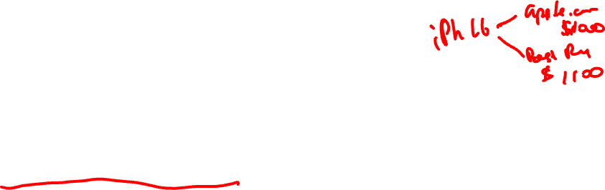
Price discrimination
Charging different customers different prices for either:
The same product
Similar (related) products produced by the same firm
These price differences must arise because of differences in demand, not the costs of serving the consumers
CMO is given the cost to produce/serve consumers by others in C-Suite
Same product
Kids prices at movies
Discounts via targeted coupons
Similar products
First class v. coach seating
Menus of cell phone service plans

Slide 28
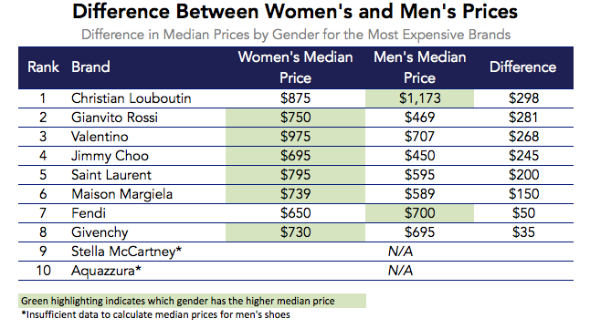
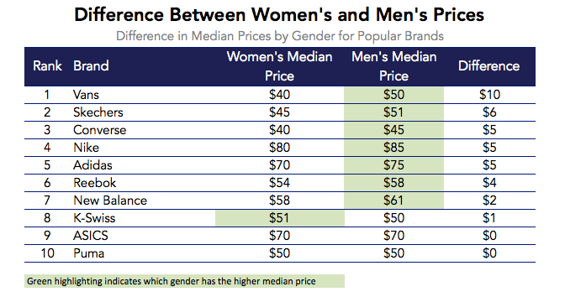
Price discrimination
Source: https://datafiniti.co/shoe-brands-change-prices-depending-gender/

Slide 29
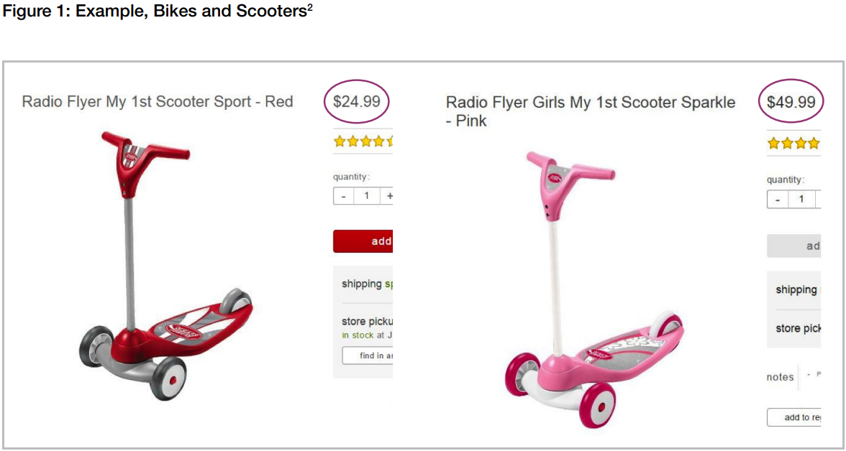
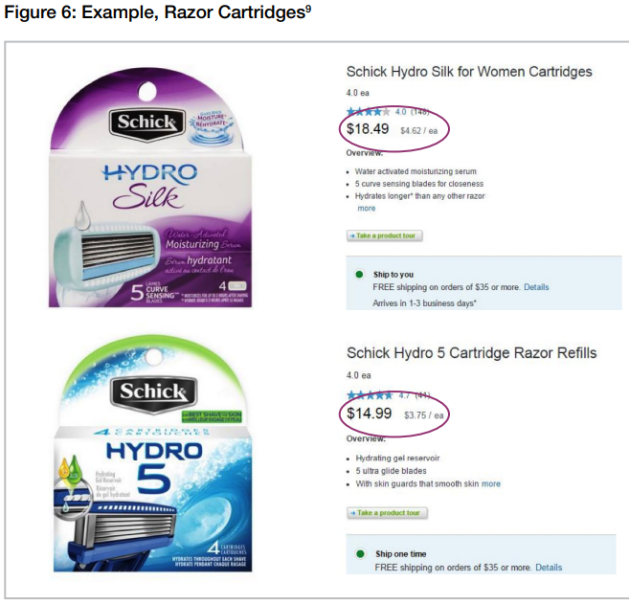
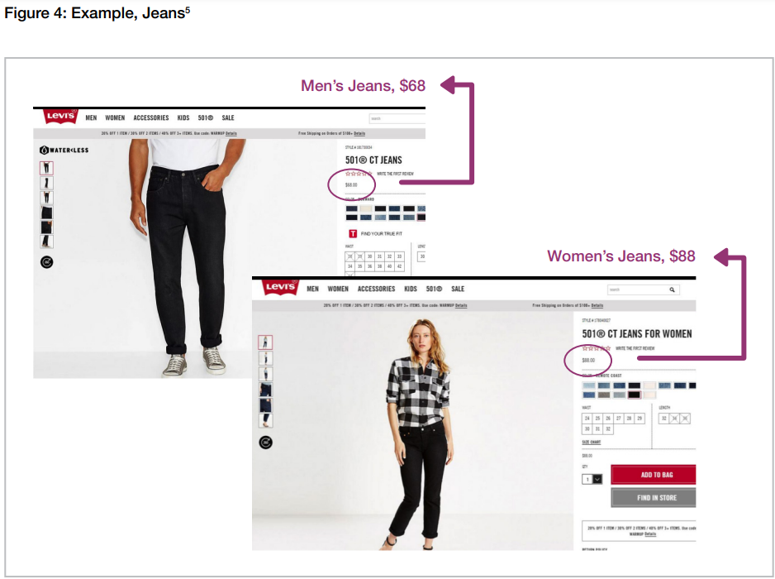

Price discrimination
Source: From Cradle to Cane: The Cost of Being a Female Consumer, NYC Consumer Affairs (https://www.nyc.gov/assets/dca/downloads/pdf/partners/Study-of-Gender-Pricing-in-NYC.pdf)

Slide 30
Price discrimination?
Different cost of production?
Men’s clothes and shoes more standardized than women’s?
Branding and design?
Color/design part of the product
Women place inherent value on some products being branded as “for women” or else enjoy the scent, colors, etc.?
Quantity differences?
Women may buy fewer units of any given brand relative to men?
For variety?
Standardized products?
Women might have a relative taste for variety and quality on surveyed products?
Women are beneficiaries?
Athletic shoes
Free cover at a bar
Source: https://www.cato.org/blog/sexist-price-discrimination

Slide 31
Three requirements for price discrimination
Firm must have market power
Competitive firms cannot charge different prices for the same product
1
Firm can identify at least two market segments with different elasticities
Depends on consumers’ personal characteristics and preferences
2
Firm can enforce price differences
Consumers targeted for the high price cannot pay the lower price instead
A restriction on resale among consumers
3

Slide 32
Differences in pricing strategies
Main differences across price discrimination methods depend on information available to the firm
How can the firm obtain information on differences among consumers?
Ask customer about characteristics, and vary price based on customer’s response
Two obvious difficulties
Can be illegal
Customers have an incentive to lie
Firms (behaving legally) must be able to enforce “honesty”
Design a menu of products
Consumers voluntarily sort themselves by their demand characteristics

Slide 33
Legal issues with discrimination
Disparate treatment
You create the rule or process to intentionally treat the protected class differently
Protected classes include sex, race, religion, national origin
E.g., the person’s race determines the price they pay off the price list
Disparate impact
You don’t intentionally try to discriminate, but the effect of your rule disadvantages the protected class
E.g., you set interest rates based on zip code

Slide 34
Three types of price discrimination
Differ by information required by the firm
First-degree
“Perfect” price discrimination
Complete information about each consumer’s tastes
Each consumer is charged the maximum price she would pay for each individual unit
Second-degree
Cannot tell consumers apart until after the purchase decision
Consumers self-select into different groups by purchasing different quantities/qualities of the firm’s product/service
Third-degree
Segment consumers into a small number of coarse groups based on objective observable traits before the purchase decision
Set MR_{i} = cost to serve for each group i

Slide 35
Types of price discrimination
1st degree price discrimination is primarily useful as an interesting benchmark
Maximum revenue firm could collect if it was omniscient and omnipotent
Actual discriminatory practices are generally either 2nd or 3rd degree
Many firms combine the two types of price discrimination
We will proceed in the following order
First
Third
Second
(Second-degree is the trickiest conceptually, but perhaps the most common)
REMEMBER: the cost to produce or serve is given to the CMO by others (COO & CFO)

Slide 36

1st degree price discrimination is perfect insight
1st degree PD
What if the firm knows everything about each of its potential customers?
Charge them each the maximum they would pay
P
Imagine firm lines up all consumers in order, from highest demand to lowest
Person with highest demand is charged P₁
Person with 2nd-highest demand is charged P₂
And so on
Revenue from each is shaded under demand
Firm serves all consumers willing to pay a price above cost to serve
P₁
P₂
Cost to produce
D
Q
Does this ever really happen?
How much information can a firm have about a customer?

Slide 37
Two key properties of 1st degree price discrimination
1st degree PD
Consumers retain no surplus
The firm captures all surplus generated in the market
1
Deadweight loss is zero
The market is efficient
2
First-degree price discrimination is probably impossible in practice, but other forms of price discrimination share some characteristics
More consumers may be served
Firm captures some of the high-demand consumer surplus

Slide 38
Example: Colleges and financial aid
1st degree PD
College applicants share a large amount of information with college admission and financial aid officers
How and why does this help colleges charge different students different prices?
What actions by applicants signal strong demand (or low price sensitivity) to a financial aid officer?
How different are the described financial aid policies from true first-degree price discrimination?
Source: “Does Federal Aid Drive College Tuition?” Regulation, Summer 2016

Slide 39
Example: Online targeting
1st degree PD
How are online retailers trying to approach first degree price discrimination?
What do you think the challenges they will face in implementing this?
With consumers?
With competitors?
Source: https://www.theatlantic.com/magazine/archive/2017/05/how-online-shopping-makes-suckers-of-us-all/521448/

Slide 40
Third-degree price discrimination
3rd degree PD
Assume the following scenario
A firm offers a single product
Consumers tastes vary for the firm’s product
When all consumers are grouped together, they have the downward-sloping demand curve P(Q)
The firm is able to divide the market into two groups of consumers (A and B) based on some easily observed attribute (e.g., age, zip code)
The two groups have different demand curves, P_{A}(Q_{A}) and P_{B}(Q_{B})
Third-degree price discrimination
Charge a different price to each group
Select the prices by finding MR_{A} = Cost to produce and MR_{B} = Cost to produce

Slide 41
3rd degree price discrimination examples
3rd degree PD
Special prices for students, senior citizens, and children
Varying textbook or pharmaceutical prices, based on the location (country) in which they are sold
Coupons are mailed to some neighborhoods but not others
Be careful to consider different production costs for different groups
E.g., drycleaners’ prices for men’s and women’s clothes
Are price differences due to price discrimination?

Slide 42
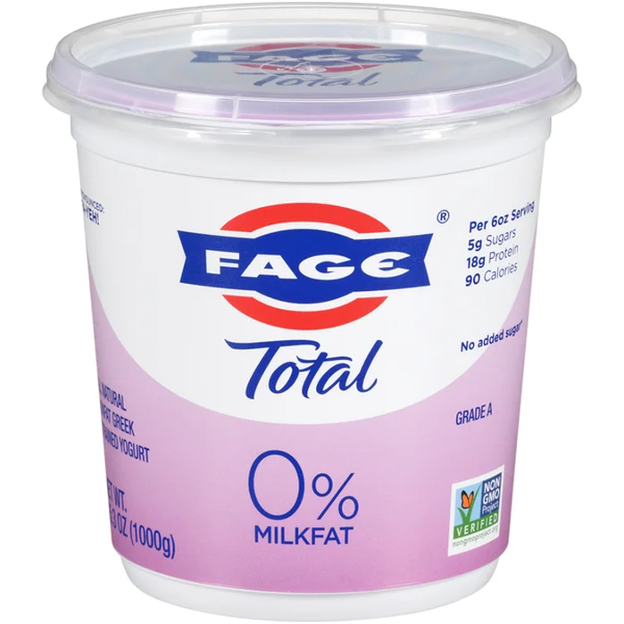

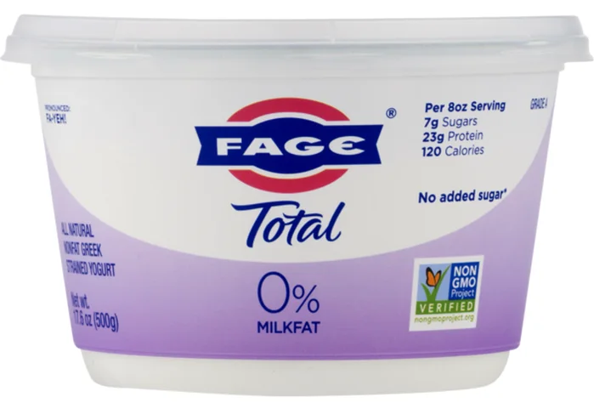


Example: Pricing Greek yogurt!
3rd degree PD
Last Thursday, Mrs. Jones went shopping
$5.99
$5.99
Notes:
Schnuck's, Public domain, via Wikimedia Commons (https://commons.wikimedia.org/wiki/File:Schnuck%27s_Logo.PNG)
See page for author, Public domain, via Wikimedia Commons (https://upload.wikimedia.org/wikipedia/commons/thumb/f/f3/Whole_Foods_Market_logo.svg/512px-Whole_Foods_Market_logo.svg.png)
https://www.instacart.com/landing?product_id=29291
https://www.instacart.com/landing?product_id=32502

Slide 43
Example: Movie prices at Tivoli
3rd degree PD
Assumptions:
Undergrads demand: P_{U} = 12 – Q_{U}
MBA students demand: P_{M} = 16 – Q_{M}
If the Tivoli cannot tell them apart, it sets MR = cost to serve ($2) for the whole market
This yields P = $8 and revenue = $96
Quantities served are Q_{U} = 4 and Q_{M} = 8

Slide 44
Example: Tivoli
3rd degree PD
Suppose Tivoli can separate undergrads from MBAs based on student ID cards
What is the optimal pricing plan?
Set MR = Cost for each sub-market
Total revenue increases to $98!
P
P
MBAs
Undergrads
16
12
Revenue_{M} = 63
Revenue_{U} = 35
9
7
Cost
Cost
2
D_{M}
2
D_{U}
7
MR_{M}
Q
5
MR_{U}
Q

Slide 45
Second-degree price discrimination
2nd degree PD
Key idea
What if the firm cannot force consumers into groups that pay different prices?
Consumers vary in their private tastes
Firm unable to observe these differences before purchase
Consumers must be convinced to “reveal” their private information
Initial insights
First studied by Jules Dupuit in mid-1800s in the context of French rail rates
Railroads could charge different prices for shipping different items (e.g., coal v. corn), but
“Passengers cannot, unlike goods, be classified by external characteristics and must be left to classify themselves”

Slide 46
Second-degree price discrimination
2nd degree PD
Firm’s strategy is to extract as much revenue from each (type of) customer while ensuring customers buy the products intended for them
This can lead to an interestingly diverse set of products
“It is not because of the few thousand francs which would have to be spent to put a roof over the third-class seats that some company or other has open carriages with wooden benches… What the company is trying to do is prevent the passengers who can pay the second-class fare from traveling third class; it hits the poor, not because it wants to hurt them, but to frighten the rich… And it is again for the same reason that the companies, having proved almost cruel to third-class passengers and mean to second-class ones, become lavish in dealing with first-class passengers. Having refused the poor what is necessary, they give the rich what is superfluous.”
Important to convince the wealthy that it is worthwhile to purchase the highest-quality product

Slide 47
Implementing 2nd degree price discrimination
2nd degree PD
Firm offers a variety of products, each aimed at different parts of the consumer population
This is what a multi-product (imperfectly) competitive firm does too!
Price discrimination must include variation in product characteristics and prices that do not simply follow costs
Firms typically use quantity or quality differences to separate consumers
Examples
Movie release timing, from theater to DVD to TV
Quantity discounts for packages of soft drinks
High-end and low-end computers or gadgets

Slide 48
Example: Cell phone
2nd degree PD
Assume two types of customers for a cell phone service firm:
Chatty undergraduates (U)
Serious MBAs (M)
Individual monthly demand for cell phone minutes in each group is:
Undergrads: P = 6 – 0.01Q
MBAs: P = 6 – 0.05Q
If the firm can choose only one per-minute price, it selects P = 3¢
Results:
Q_{U} = 300 Revenue_{U} = 300x3¢ = $9.00
Q_{M} = 60 Revenue_{M} = 60x3¢ = $1.80
Notes:
P = 6 – 0.06Q
MR = 6 – 0.12Q
MR = MC
6 – 0.12Q = 0
12/100Q = 6
Q = 100*6/12 = 100/2 = 50
P = 6 – 0.06*50 = 6 – 3 = 3
QU: 3 = 6 – 0.01Q => 0.01Q = 3 => QU = 300
QM: 3 = 6 – 0.05Q => 0.05Q = 3 => QM = 60

Slide 49
Example: Cell phone
2nd degree PD
The firm would like to tailor different plans to different groups, extracting some of the consumer surplus
Consider the following plan:
4¢ per minute for the first 30 minutes
3¢ per minute between 30 and 300 minutes
2¢ per minute for minutes beyond 300
What is the effect on the consumers?
Remember the height of demand at a specific quantity is the marginal willingness to pay for the next unit of a good
So, an MBA with demand of P = 6 – 0.05Q who spent 30 minutes on the phone this month is willing to pay up to 4.5¢ for the next minute on the phone

Slide 50
Example: Cell phone
2nd degree PD
For MBAs, the pricing plan has the following effect
4¢/min.: < 30 min., 3¢/min.: 30 - 300 min., 2¢/min.: > 300 min.
P
MBAs willing to spend at least 30 minutes on the phone for 4¢/min, so they do
Revenue contribution = $1.20
6
4.5¢
4
MBAs will spend additional 30 minutes on the phone for 3¢/min
Additional revenue contribution = $0.90
3
Total revenue from MBAs = $2.10
Up from $1.80
30
60
120
Q
Could you alter this plan and raise more money from the MBAs?

Slide 51
Example: Cell phone
2nd degree PD
For Undergrads, the pricing plan has the following effect
4¢/min.: < 30 min., 3¢/min.: 30 - 300 min., 2¢/min.: > 300 min.
P
Pay 4¢/min for first 30 minutes
Revenue = $1.20
5.7¢
6
Pay 3¢/min for next 270 minutes
Revenue = $8.10
4
3
Pay 2¢/min for next 100 minutes
Revenue = $2.00
2
Total revenue = $11.30
Up from $9
Q
30
300
400
600
Could you alter this plan and raise more money from Undergraduates without an effect on MBAs?

Slide 52
Example: Cell phone
2nd degree PD
What has happened under the new cell phone pricing scheme?
Firm successfully separated types of consumer
Firm took back some consumer surplus on the first 30 minutes of calls per month
Outcomes reflect important components of 2nd price discrimination
Voluntary separation of consumers by their own purchasing behavior
Construction of prices to reduce consumer surplus

Slide 53
Example: Broadway ticket prices
2nd degree PD
How Broadway producers use variation in ticket quality (i.e., where the seat is) as a type of second-degree price discrimination?
Why?
How does the TKTS booth (day-of-show discounts) facilitate price discrimination?
Is a ticket sold at the TKTS booth the same product as a ticket purchased over the phone?
What pricing practices rely on knowledge of which consumers will pay more (or less) for ticket?
Source: Hal Varian, “Raising the curtain on the dynamics of pricing tickets for Broadway shows,” NYT, January 13, 2005

Slide 54
Examples of behavioral biases: Pricing
Anchoring
Tendency to focus on one piece of evidence – usually the first information seen
Fail to adjust away from that initial anchor
E.g., Attila the Hun and the cell phone
Be careful with initial pricing – customers will anchor on it and it can be hard to modify

Slide 55
Agenda
Revenue maximization
Monopoly pricing
Price discrimination
Two-part tariffs
Bundling
Adverse selection
American Airlines case

Slide 56
Price discrimination extension: Two-part tariffs
Two-part tariff
Firm charges fixed fee (F) for “right” to purchase a product, and p per unit purchased
Sometimes called two-part price
If you buy Q units, total payments to the firm are
T(Q) = F + pQ
Examples
Golf club membership plus greens fees for each round
Personal Seat Licenses (PSLs) for sports teams: Pay an up-front fee for the “right” to buy season tickets
2nd degree price discrimination
Can be viewed as 2nd-degree price discrimination
Two-part tariff has decreasing average price per unit
Similar to a quantity discounting

Slide 57
How should the fee and price be set?
Suppose that there is one type of buyer:
Fee (F) = Consumer surplus
Price (p) = Cost to produce (just cover costs)
P
Fee
Cost to produce
P*
D
Q*
Q

Slide 58
Consumer surplus
Remember Jose’s take-it-or-leave it offer?
Consumer surplus + (price/can)*(# of cans)
Like assuming costs Coca-Cola $0.50 to produce each can of Coke
P
2
Take-it-or-leave-it offer of $3.75
0.5
3
4
Q

Slide 59
How should the fee and price be set more generally?
With more than one consumer type, high entry fees deter some consumers altogether
Very hard to find optimal strategy in practice!
Do the math!!
1,000 high preference types and 25 low preference types: likely charge the high preference consumer surplus as fee
2,000 low preference types and 10 high preference types: likely charge the low preference consumer surplus as fee
Basic rule: entry fee should equal the consumer surplus of the marginal buyer
As per-consumer entry fee rises, revenues initially increase, then start to fall as more customers are excluded

Slide 60
Extended example: Buying the TCSB
Three tennis enthusiasts were thinking about buying the Tennis Club of Santa Barbara (TCSB)
A key part of the decision was thinking about alternative methods to increase revenue at the club
The club had low prices and was making a small profit (sat on spectacular real estate…we will ignore that part!)
The TCSB had plenty of courts (36) so assume no constraints on court time
What else should we learn about?

Slide 61
Buying the TCSB: Customers
Currently, there are 2,000 members of the TCS who pay $2/hour for court time
Looking at the TCS’s current membership, there were basically 2 segments of players of roughly equal size
Serious players
Type 1: Q₁ = 6 – p
Q₁: court hours per week
P: court price/hour for an individual player
Recreational players
Type 2: Q₂ = 2 – 0.5p
Should we continue to charge $2/hour for all players?
Is there a price that we can charge that will increase revenue?

Slide 62
Buying the TCSB: Demand curves
P
6
4
Serious players
Rec players
Q
2
6

Slide 63
Buying the TCSB: Price discrimination
Think about Serious Players first
Weekly revenue from a Serious Player = p₁*Q₁ = (6 - Q₁)*Q₁
1,000 Serious Players, so weekly revenue is 1,000*(6 - Q₁)*Q₁ = 6000Q₁ - 1000Q₁²
MR₁ = 6000 – 2000Q₁
Setting MR₁ = 0, we get 6000 – 2000Q₁ = 0
Optimal Q₁ = 3 and p₁ = 3
If charge $3/hour court fee, each Serious Player will play 3 hrs/week (3,000 hours in total)
What about the 1,000 Rec Players?
Can show optimal p₂ = 2 and Q₂ = 1 (1,000 hours total)
Weekly revenue = $3*3,000 + $2*1,000 = $11,000/week
Was $10,000 ($2*5,000 hours)
Notes:
Q = 3 – 0.5p => p = 6 – 2Q
Revenue = (6 – 2Q)*1000Q = 6000Q – 2000Q2
MR = 6000 – 4000Q
MR = 0 => Q = 6/4 = 1.5; p = 3

Slide 64
Buying the TCSB: Membership fee
Assumed we could identify Serious Player from Rec Player and charge them different prices
In addition, seems like we are leaving some consumer surplus on the table
What if you adopt a two-part tariff and charge a membership fee?
One partner argued the club should cater only to Serious Players
How would you set up two-part tariff to cater only to Serious Players?

Slide 65
Buying the TCSB: Capture CS
Set p = cost to provide, and then pick the fee F to capture consumer surplus of Serious Players
Serious Players’ demand curve lies outside Rec Players’ demand curve
Capturing Serious Players’ consumer surplus implies Rec Players will not want to join
p = cost implies p = 0 [no constraints on providing court time]
Serious Player consumer surplus?
P
6
Calculate area under the Serious Player’s demand curve [Q₁ = 6 – p]
Area = 0.5*6*6 = 18
4
Charge Serious Player annual membership fee = 52*$18 = $936
Serious
Weekly revenue = 1,000*$18 = $18,000 per week
Higher revenue by charging membership fee screening out Rec Players!
Rec
Q
2
6

Slide 66
Agenda
Revenue maximization
Monopoly pricing
Price discrimination
Two-part tariffs
Bundling
Adverse selection
American Airlines case

Slide 67
Bundling
How might a firm sell two products together in order to increase revenue?
Bundled pair of products cannot be purchased separately
Necessary conditions
Same as for price discrimination …
Market power
Information about variation in consumers preferences
No resale of products
Examples
A news site is a bundle of different sections
Car’s manufacturer might offer premium radio and sunroof together in an unbreakable “luxury package”

Slide 68
Bundling
Ability of bundling to improve revenue depends on correlation in consumer’s demand
Example
Suppose Apple has two products to sell: iPhone (iP) and Apple Music (AM)
Consumers have a maximum price, r, they are willing to pay for each product
If P ≤ r, the consumer will purchase
Value of both together is r_{iP} + r_{AM}
Suppose there are two consumers (A and B) with r values of:
 | iPhone | Apple Music
Consumer A | 770 | 300
Consumer B | 850 | 250

Slide 69
Bundling: Negative correlation
Separate sales
Charge $770 for iPhone and $250 for Apple Music
Revenue is $1,540 + $500 = $2,040
Bundled sale
Charge $1,070 for the bundle
Revenue is $1,070 + $1,070 = $2,140
Why did bundling raise more revenue than individual sales?
Consumers’ demand is negatively correlated
Consumers use high surplus from more-favored product to effectively cross-subsidize the purchase of the less-favored product
 | iPhone | Apple Music
Consumer A | 770 | 300
Consumer B | 850 | 250

Slide 70
Bundling: Positive correlation
Bundling is not beneficial when demand is positively correlated
Suppose demand for iPhone and Apple Music has the following properties:
 | iPhone | Apple Music
Consumer A | 850 | 300
Consumer B | 770 | 250
Two pricing strategies:
Lower-r consumer “sets” price in both cases
Separate sales
P_{iP} = 770 and P_{AM} = 250
Revenue is $2,040
Bundled sale
Price is $1,020
Revenue is $2,040

Slide 71
Other reasons for bundling
Why else would a firm bundle products, if not to increase profit?
Efficiency in production and distribution
Auto parts v. whole car
News sites
Assure quality
Microsoft’s claims about complementarity between Windows and IE
Kodak used to require its own paper in its film development
Bundling simply to increase profit is illegal, so firms and regulators may argue about whether there is an efficiency/cost or quality reason for a bundle

Slide 72
Practices related to bundling
Mixed bundling
Offer bundle plus the possibility of buying the products separately
Why do this?
If cost to produce > 0, firm doesn’t want to “force” a consumer with r < cost to purchase a good with little value to him
Example: Combo meals at fast food restaurants
Tying
Require consumer to buy one product as a condition for buying a separate product
This is illegal
Generally, the firm ties the purchase of a product for which it has competition with a product over which it has market power
Examples: IBM punch cards and computers, Microsoft Windows and IE

Slide 73
Pricing strategy summary
Two-part tariffs allow firms to directly capture consumer surplus through the fixed fee
Bundling is a form of price discrimination
Negative correlation of the preferences is necessary
Coupons allow greater revenue even without correlation

Slide 74
Agenda
Revenue maximization
Monopoly pricing
Price discrimination
Two-part tariffs
Bundling
Adverse selection
American Airlines case

Slide 75
Asymmetric information
Definition
A market, or situation, where the sellers have more information about the quality of a product than buyers (or vice versa)
Three primary areas where it comes into play…
Adverse selection
The “lemons” problem that occurs prior to the signing of a contract (or forming a relationship)
Moral hazard
Potentially perverse incentives that occur after signing the contract (or forming the relationship)
Principal-agent
Conflicting interests of the parties to the contract (or relationship)

Slide 76
Quality uncertainty and the market for lemons
Commonly said that the moment you drive your new car off the dealer’s lot, the value of the car drops 20%
Why is this?

Slide 77
The market for lemons
Think about the market for used cars in which the following is true
2 types of cars
High Quality (Peaches)
Low Quality (Lemons)
Buyers agree
Peach is worth $10,000
Lemon is worth $5,000
Knowledge
Sellers know if their car is a Peach or Lemon
Buyers don’t know if a car is a Peach or Lemon
Asymmetric Information
Assume Buyers believe 50% of used cars are Lemons
What is the equilibrium price of used cars in this market?

Slide 78
Example: Health insurance
Suppose you are a manager for an HMO (Health Maintenance Organization) that provides health insurance
You are deciding whether to raise health insurance premiums for new patients
Should you do it?
Suppose you raise your premiums and your competitors do not
Who will you attract to your HMO?

Slide 79
Example: Health insurance
There is asymmetric information in the market
Consumer has more knowledge of her underlying health and demand
If you raise the premium from $500 to $1,000
Attract/keep patients whose expected value of health insurance ≥ $1,000
You would likely attract many more bad risks (go to the doctor often, in generally poorer health)
In the short run you might earn higher profits, but in the long run your profits could be lower (higher payouts)
By raising premiums, you may eliminate the good risks that pay for the bad risks

Slide 80
Signaling
Adverse selection suggests that extra information will solve the problem
Good car owners want to show that their car is good
Low risk types want cheap insurance
Banks and lenders want to lend to reliable borrowers
Some individuals want to signal their information
It is important these signals are believed
Owners of a bad car also want buyers to believe it is good
To avoid adverse selection, it is necessary for signals to be sent and for the signals to be credible

Slide 81
Methods to signal quality
Reputation
In the used car market, why is quality often signaled by the fact that the car is sold by a new car dealer, rather than a used car dealer or private individual?
Guarantees and warranties
When will a signal be credible?
Why don’t low-quality sellers just lie?
The cost of the signal must be inversely related to the quality of the product

Slide 82
Warranties in the lemons market
What kind of warranty would have to be offered in the car example?
Suppose high quality car sellers can offer a warranty on their cars in which they offer to fix the car if it breaks in a specified period of time (say 2 years)
The cost of offering the warranty to the high-quality sellers is $500
Will this warranty be a credible signal to consumers that the car is high quality?

Slide 83
Warranties in the lemons market
Depends on how much it costs low-quality sellers to offer the same warranty
Suppose warranty also costs low-quality sellers $500
Sellers of Lemons will also offer the warranty
If both high- and low-quality sellers offer the same warranty, buyers can’t use the warranty to distinguish Peaches from Lemons
Lemon seller did not offer warranty, would only get $5,000
If does offer the warranty, might convince buyer to pay expected value of car ($7,500), so Lemon owner’s profit is $7,000
Warranty is not a credible quality signal because all sellers will offer one

Slide 84
Warranties in the lemons market
Warranty cost to Lemon seller is probably higher than cost for Peach seller
Low quality cars more likely to break down, will cost more to fix
Suppose warranty costs $500 for Peach seller, and $3,000 for Lemon seller
Is the warranty a credible quality signal?
Offer warranty: $4,500; don’t offer: $5,000
In adverse selection markets, individuals will truthfully reveal their information if it is in their economic self-interest to do so
When the cost of the signal is negatively related to quality

Slide 85
A worker signaling model
Why do MBAs get paid more than non-MBAs?
Consider the following model
Two types of workers
50% are low productivity and produce 1 unit of output
50% are high productivity and produce 2 units of output
Each worker lasts 10 years with a firm
Output sells for $10,000
Each low type is worth $10,000/year
Each high type is worth $20,000/year
What is the firm willing to pay high and low type workers?

Slide 86
A worker signaling model
High types have an incentive to distinguish themselves from low types
Is schooling a signal of worker type?
y is the years of college a worker gets
It costs $40,000y for a low type to get y years
It costs $20,000y for a high type to get y years
Education has no effect on productivity!
Let firms offer wages of $20k to anyone with at least 4 years of college and $10k to anyone with less
Who should go to college?

Slide 87
A worker signaling model
4 years of college earns $200k = $20k*10, otherwise earn $100k
High types will go to school, and low types will not
Education is a signal that people with degree have other abilities too
Important the signal is more costly for the bad types to acquire than the good types
Cost = 40k * y
Low types
Benefit of y years
4
y
High types
Cost = 20k * y
Benefit of y years
4
y

Slide 88
Agenda
Revenue maximization
Monopoly pricing
Price discrimination
Two-part tariffs
Bundling
Adverse selection
American Airlines case

Slide 89
Price discrimination
What kind of price discrimination is this case about?

Slide 90
Discussion question
How are pricing, customer relationships, and route structure both strategic (big-picture) and tactical (detailed) decisions for American?

Slide 91
Discussion question
Refer to the discussion of the Chicago-West Coast pricing decision in the case: Should American counter Continental's $159 fare with a relatively unrestricted discount fare on the nonstop Chicago-West Coast flights?

Slide 92
Discussion question
Refer to the discussion of the New York-San Juan pricing decision in the case. What additional information should Doug Santoni collect to decide on a response to Eastern's pricing initiative?

Slide 93
Discussion question
Consider the example on p. 6 of the case. An aircraft has 100 seats, and there are two types of fares: full ($499) and discount ($99). While there is unlimited demand for discount fares, demand for full fares is estimated to be anywhere between 10 and 30. How many seats should be protected for full-fare passengers? (In particular, how would you go about determining the answer?)

